Slide 1

Cassie Kinoshi
the colour of all things constant
Primary Classroom Lesson Plan
Written by Andrea Price

Slide 2

Lesson outcomes
Learners will:
Engage with a contemporary work for Soprano, Alto, Tenor and Bass (SATB) chorus and orchestra
Make connections between sound and movement, colour, and emotion
Express themselves through improvised and composed responses to the piece

Slide 3
Resources required
Coloured objects (mixed) / coloured fabric
A large space for moving in response to the music
Colourful scarves or fabric, ribbons, paper for dancing / twirling to the music
Tuned and untuned classroom percussion
Metallic objects such as keys, wind chimes, or safe metallic objects for sound experiments
Wooden or hollow objects and shells for sound experiments

Slide 4
Curriculum Checklist
National Curriculum in ENGLAND (KS2)
Play and perform in solo and ensemble contexts, using their voices and playing musical instruments with increasing accuracy, fluency, control and expression.
Improvise and compose music for a range of purposes using the interrelated dimensions of music.
Listen with attention to detail and recall sounds with increasing aural memory.
SCOTLAND Curriculum for Excellence (Second Level)
Recognise a range of musical styles and identify some of the main instruments in the genre.
Use voice, instruments and technology to create music, experimenting with timbre.
Perform on instruments, individually or as part of a group, to communicate the mood and character of a piece of music.
Curriculum for WALES: Expressive Arts (Progression Step 3)
I can explore and describe how artists and creative work communicate mood, feelings and ideas and the impact they have on an audience.
I can reflect upon how artists have achieved effects or communicated moods, emotions and ideas in their work.
I can identify and response creatively to challenges with resilience and flexibility.
NORTHERN IRELAND Primary Curriculum (KS2)
Work creatively with sound by creating musical stories, pictures, patterns, conversations, and accompaniments.
Sing and perform with simple instruments from memory, by ear or from notation to develop vocal and instrumental skills.

Slide 5
Glossary of music terms
Term | Definition
Accompaniment | Music that has a supporting role
Dynamics | How loudly or quietly a piece of music should be played
Key signature | Tells you what the key note is and what sharps or flats are in a piece of music – a piece can be in a major or minor key
Major key | Bright-sounding – see here for examples
Minor key | Dark-sounding – see here for examples
Ostinato | Rhythm or melody that constantly repeats
Pitch | How high or low a sound is
Texture | How we combine, mix and layer sounds (how ‘thick’ or ‘thin’ the music is, e.g. how many instruments are playing, how they are being played etc.)
Tuned classroom percussion | Instruments with a defined pitch such as glockenspiel, xylophone, chime bars etc.
Untuned classroom percussion | Instruments without a defined pitch such as claves, castanets, shakers, hand drums etc.

Slide 6
Lesson 1
Connecting music with colour, movement and shape
Copyright Andrea Price & BBC

Slide 7

Background – the composer
Cassie Kinoshi (b. 1993)
Saxophonist, composer and arranger.
Nominated for a Mercury Prize in 2019 and in 2018 won an Ivors Academy Award in the Best Jazz Composition for Large Ensemble category.
As a bandleader, she writes for and performs with her ten-piece ensemble seed. which features many top London-based improvising musicians.
Composition graduate of the Trinity Laban Conservatoire of Music and Dance, where she studied with Andrew Poppy and Stephen Montague.
Commissioned by the London Symphony Orchestra, London Sinfonietta, London Contemporary Orchestra, Manchester Camerata amongst others.

Slide 8


Background – the music
the colour of all things constant
The music is written for choir and orchestra.
The words come from a poem called Kindness, written by Zimbabwean-born poet Belinda Zhawi. Zhawi describes herself as a sound-artist, as she often creates musical accompaniments or soundscapes for her poems.
The poem describes kindness as a constant amongst chaos. The music cleverly evokes this by creating contrasting moments of busyness and stillness, all centred around one note heard throughout most of the piece - the note G.
The orchestra is used in very colourful ways – look out for the interesting percussion instruments, listen to the beautiful sound of the harp, and be amazed by the variety of techniques and effects Cassie achieves with the string, woodwind and brass instruments.

Slide 9
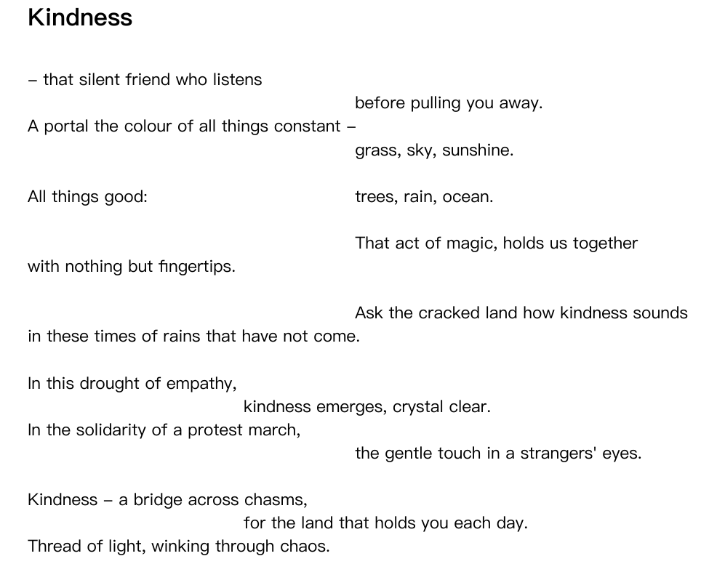
Notes:
Prepare your class
Explain to the class that you are going to begin a music project focusing on a brand new piece of music by Cassie Kinoshi, a British composer who has written this piece of music especially for this exciting project! The piece is called “the colour of all things constant”. The piece uses an orchestra and a choir, and has words written by Belinda Zhawi. The poem is called Kindness. Let’s read and explore the poem.
There are two important themes in this poem. One is kindness, and the other is about nature. Can you find any words in the poem that are related to kindness? Can you find any words in the poem that are related to nature?
Can you make any connections between kindness and nature?

Slide 10

Watch the Introductory Film
https://www.bbc.co.uk/teach/ten-pieces/articles/zxpvjfr
Notes:
Watch the film and as a class, have a discussion about it – see next slide for questions for the class.

Slide 11
Questions
Do you remember which instruments Cassie can play?
Do you remember what Cassie enjoys about playing and composing music?
Do you remember how Cassie goes about writing music?
What interesting things did you notice about the piece being recorded?

Slide 12
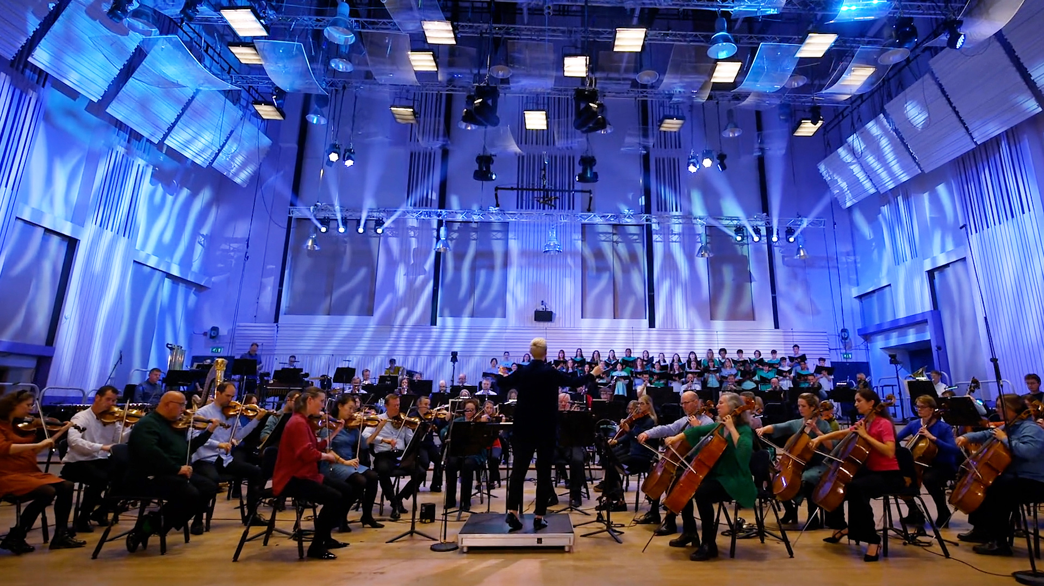
Listen and Reflect
https://www.bbc.co.uk/teach/ten-pieces/articles/zxpvjfr
Notes:
2. Explain that you are going to listen to the music, and see if you can find connections between sound, colour, and texture (density). This activity can be done in different ways. Start by listening to small sections of the music, and practise describing how the music feels:
Question prompts:
The music might feel bright when the pitch is high, or in a bright major key. The music might feel dark when the pitch is low, or when the music is in a darker minor key. Can you decide if the music feels bright, dark, or somewhere in between?
The music might feel busy (you can use the vocabulary word texture – which describes how ‘thick’/dense, or ‘thin’/empty the sound is i.e how busy the sound is). Can you decide if the music sounds a) thick or thin, and b) feels busy, empty, or somewhere in between?
3. Now listen to the complete piece of music, and show the brightness and texture (density) of the music by interacting with coloured objects in the room. This activity could be done in a number of different ways:
Different coloured objects with different sizes, weights, and textures (paper / ribbons / balls / other objects) on tables or on the floor that the children can choose between to touch or hold in response to different parts of the music.
Differently coloured fabrics that the children can hold in response to different parts of the music, gathering more of the colour when the density feels stronger/texture feels ‘thicker’.

Slide 13


Time to move!
Notes:
4. Move into a larger space, or clear space in the classroom. You are now going to listen to the music again, and see if you can find connections between sound, movement, and shape. Using juggling / dance scarves or ribbons as props, respond to the music with movement.
Allow the children to move freely at first and then guide towards some ‘agreed’ movements.

Slide 14
Bright
Twirling slowly with the scarf held above your head
running with the scarf
Twirling quickly with the scarf held above your head
Throwing the scarf into the air and gently catching it
writing words in the air with the scarf, high and slowly
writing words in the air with the scarf, high and quickly
Empty
(thinner texture)
Busy
(thicker texture)
writing words in the air with the scarf, low and slowly
writing words in the air with the scarf, low and quickly
Twirling quickly with the scarf at knee height or on the floor
Trailing the scarf slowly along the floor
Twirling slowly with the scarf at knee height or on the floor
leaping with the scarf, moving it in large circles
Dark
Notes:
Here are some suggested movements in response to the brightness and texture of the music. Feel free for keep this on the board for students if they need creative prompts/support.

Slide 15
Time to Reflect
How did the music feel?
Notes:
5. Have a calm moment at the end of the session, and ask the children to each take turns to be “the silent friend who listens” while another student describes how the music felt.

Slide 16
Lesson 2
Connecting music with colour and nature
Copyright Andrea Price & BBC

Slide 17
Listen and Move
Performance film thumbnail
https://www.bbc.co.uk/teach/ten-pieces/articles/zxpvjfr
Notes:
Re-visit and further develop the scarf dancing activity from the previous session.
After some time experimenting to the music, ask for a volunteer to act as the director. The director should make choices about texture (busyness) by asking other students to start or stop their chosen movements, using an agreed physical gesture (rather than a verbal response). Explain that this directing skill will be used again later during group work.
This activity can be repeated several times to encourage multiple volunteers. A way of extending this activity would be to split into smaller groups and have multiple directors at the same time.

Slide 18
Notes:
2. Revisit the poem and focus on the words about nature. Ask students to think of colours that would suit the different nature words in the poem.
Here is a suggestion of how the nature words could be categorised into colours:
Green – grass / trees
Blue – rain / ocean / sky
Golden – sunshine / light / crystal / sky
3. Explain that you are going to create nature soundscapes using percussion instruments and objects found in nature. Belinda Zhawi often creates soundscapes to go with her poems. You are going to create soundscapes to suit the nature words from Belinda’s poem. Teachers could prepare for this session in advance by encouraging students to collect and bring in some objects that link to nature.
Here are some objects that would be effective as part of a nature soundscape when used alongside tuned and un-tuned percussion instruments:
Green group - hollow wooden objects, coconuts, bamboo, rattan/reeds to rustle
Blue group - shakers / rain sticks / ocean drums made using beans/lentils. Shells.
Golden group - metallic objects (keys / metal plant pots etc.)

Slide 19
















Let’s make musical soundscapes!
Notes:
4. Divide the class into three or six groups and assign a colour to each group. Give each group a selection of percussion instruments and ‘found sounds’, to suit their colour. The groups should experiment with their instruments and ‘found sounds’, to create a musical soundscape that suits their colour.
Each group should have one student who does not play an instrument (they can swap around), and takes on the role of the director. Remind students that the role of the director is to use an agreed physical gesture to start and stop individuals and the entire group, and to choose a gesture to indicate that students should play in a more or less busy way. The directors could use a scarf to help with giving directions (this may help some children and hinder others).

Slide 20

Time to share!
Notes:
5. Bring the class back together and listen to their soundscape experiments. Ask the rest of the class to listen carefully, watch the directors carefully, and give some feedback. Ask for positive comments, and helpful comments that groups could use to improve their work further.

Slide 21
Lesson 3
Connecting music and poetry
Copyright Andrea Price & BBC
Notes:
1. Before the lesson.
Students will need to have poems to read alongside their accompaniments for this lesson. They could use existing poems about colours, kindness, and / or nature, or spend some time working on “colour of kindness” poems in advance of the lesson. Here is an example of how a “colour of kindness” poem could be structured:
Blue is the colour of kindness
The soft blue blanket used to swaddle the baby
The bluebells that shelter the bugs and bees
The blue sapphire that my grandma wears
Our fragile blue planet, that so desperately needs our care
Blue is the colour of kindness

Slide 22
Watch the orchestral performance
Performance film thumbnail
https://www.bbc.co.uk/teach/ten-pieces/articles/zxpvjfr
Notes:
2. Get ready for learning by watching the performance of ‘the colour of all things constant’. During the performance, think about the experiments on sound that you have done so far. Recap and discuss the themes of kindness, of colour, and of nature found in the words of the poem and expressed in the music.
3. Watch part of the performance again, and this time focus on the instruments and voices you can see and hear. See how many instruments you can name!
4. Watch another part of the performance, and this time focus on the texture (density – i.e how ‘thick’ or ‘thin’ the sound is) of the music. Pay particular attention to when everyone is playing at the same time, and when only a few people are playing. Discuss how the texture (density) and volume (dynamics) of the orchestra changes when we need to hear the words sung by the choir.

Slide 23
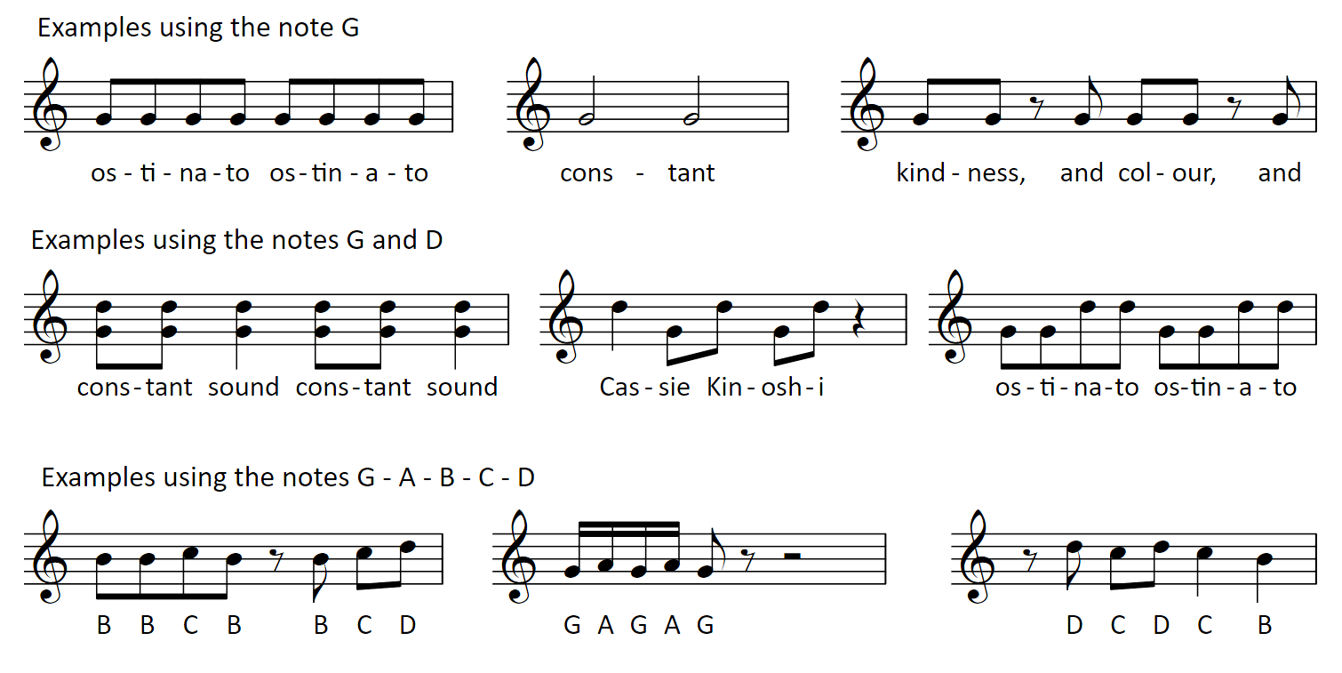
Let’s create a musical accompaniment!
For guidance on notation, please see here.
Notes:
5. Explain that, in this lesson, you are going to create a musical accompaniment to support the reading of a poem. In “the colour of all things constant”, Cassie Kinoshi creates lots of musical colours with the instruments and voices, but she also creates a sense of “all things constant” by using one note, the note G (perhaps G for good!) that can be heard most of the time during the piece!
6. Divide into groups, and select a poem (or poems) for each group to work with. Each group should create an accompaniment using tuned percussion instruments, and if needed, a selection of un-tuned instruments and ‘found sounds’ that would suit the theme of the poem. One or two students could read the poem instead of playing an instrument, or more students could take turns to read a line each. The poem should be read over the top of the music. This will help students to project with confidence when speaking out loud.
7. Creating an effective accompaniment
Constant sound in music can be created by repeating ideas. A repeated musical idea is called an ostinato. Here are some ostinatos that you can practise and combine together to create your accompaniment. Don’t forget, an ostinato means that you should play the same idea over and over again. You could combine these ideas in lots of different ways, and create your own ideas using the notes G – A – B – C – D to go with them.
Practise playing your music at different dynamics (volume). Try playing the music at a loud dynamic and at a quiet dynamic. What dynamic should you play at when the poem is being spoken? What dynamic could you use before and after the poem is spoken?

Slide 24
Time to share!
Notes:
8. Bring the class back together and perform the poems and accompaniments. Ask the rest of the class to listen carefully and give some feedback. Ask for positive comments, and helpful comments that groups could use to improve their work further. Have the groups successfully explored dynamics? Could you hear the note G used as a constant sound in the accompaniment? Could you hear ostinatos being played?

Slide 25
Lesson 4
Connecting music and kindness
Copyright Andrea Price & BBC

Slide 26
Notes:
1. Explain that this lesson is an opportunity to refine and showcase all of the work you have done on this project. Start by reading the Kindness poem out loud, and remind students that the purpose of this project is for the students to express themselves, and to reflect on how other people use music to communicate feelings and ideas.

Slide 27
Our nature soundscapes
Notes:
2. Spend a short time recapping and developing the nature soundscapes, with groups working on the feedback they received in the previous lesson and giving more directors the opportunity to shape the music by controlling the texture (density) and dynamics (volume).
3. Perform the soundscapes to each other again and focus solely on kind comments. Encourage students to comment on the role of the director as well as the music.
4. Spend a short time recapping and developing the poem accompaniments, with groups working on the feedback they received in the previous lesson and giving more students an opportunity to have their poems read aloud.
5. Perform the accompanied poems to each other again and focus solely on kind comments. Encourage students to comment on the spoken words as well as the music.

Slide 28
Listen to ‘the colour of all things constant’
Performance film thumbnail
https://www.bbc.co.uk/teach/ten-pieces/articles/zxpvjfr
Notes:
6. Listen to “the colour of all things constant” one more time and see if students can further improve on their discussions about the music, using appropriate vocabulary to describe instruments, pitch, texture, and dynamics.

Slide 29
Listen and Reflect
https://www.bbc.co.uk/teach/ten-pieces/articles/zxpvjfr
Notes:
7. Watch the interview with Cassie Kinoshi one more time, and reflect on what it means to be a composer. As this piece has been written especially for this project, you might even decide to make a thank you card for Cassie that could go on display at your school!

Slide 30
Taking it further – cross curricular activities
LITERACY – writing poems about kindness, colour, and nature
ART & DESIGN – create wind chimes and ocean drums out of recycled materials and use in the lessons as percussion instruments

